Slide 1
FINAL exam REVIEW
APS106

Slide 2
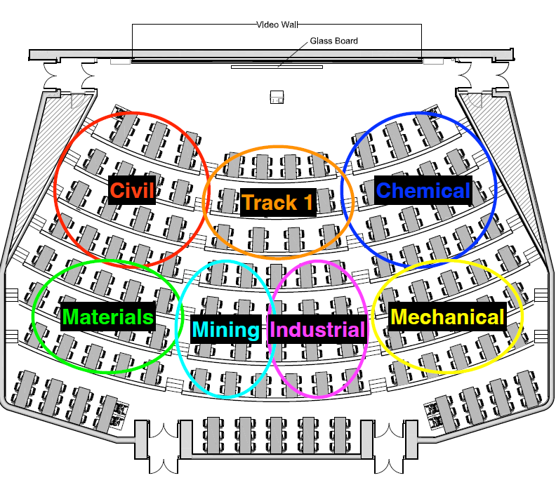

Slide 3
Rules of the GAME
Must use button on the table to answer question verbally and explain your answer – you will be called on to answer by one of the instructors
Must tell us which discipline you’re in before you answer for points (we’ll rely on the honour system)
If you get the answer right, you pick the next category
If you get the answer wrong, the next person whose hand is up can steal
Everyone is here to learn and review for the midterm so be kind to everyone who answers!

Slide 4
Panel
GOODFILE-AS
IT’s A WONDERFUL APS106
CITIZEN KANE-TAINER
12 angry methods
$250
$250
$250
$250
$500
$500
$500
$500
$750
$750
$750
$750
$1000
$1000
$1000
$1000

Slide 5
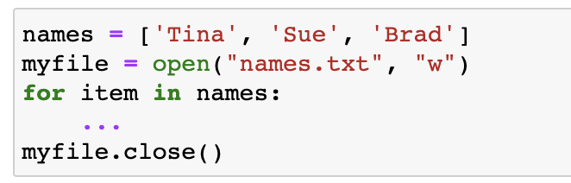

What is the missing line of code to write the names into names.txt?
Goodfile-as · $250
Question board

Slide 6
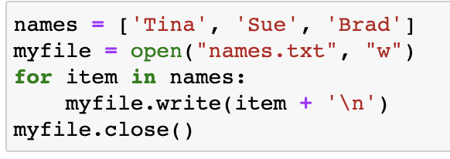
What is the missing line of code to write the names into names.txt?
Goodfile-as· $250
Modified from 2018 final exam
Question board

Slide 7
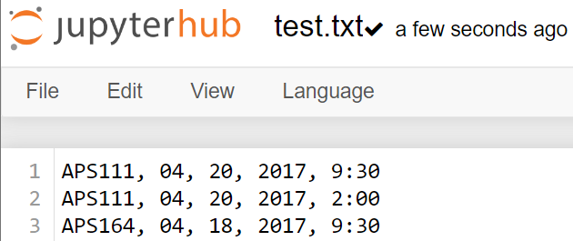
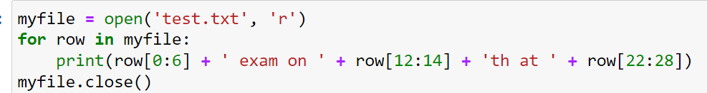
What is the output?
GOODFILE-AS · $500
Question board

Slide 8
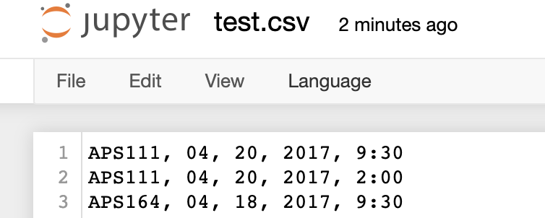
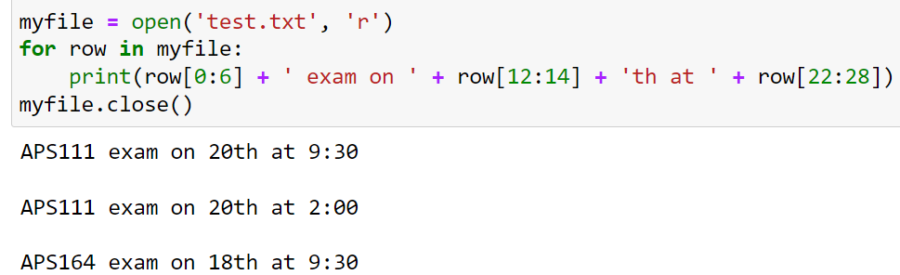
GOODFILE-AS · $500
Question board

Slide 9
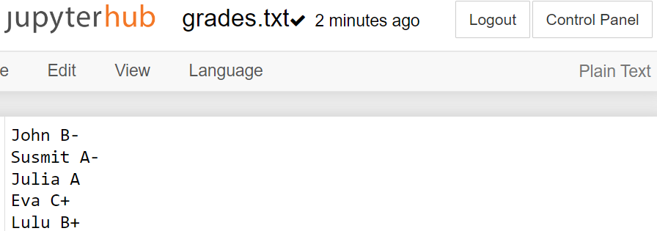
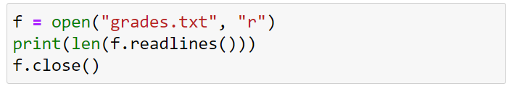
What is the output?
GOODFILE-AS · $750
Question board

Slide 10
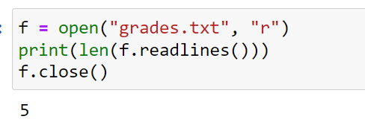
What is the output?
GOODFILE-AS · $750
Question board

Slide 11
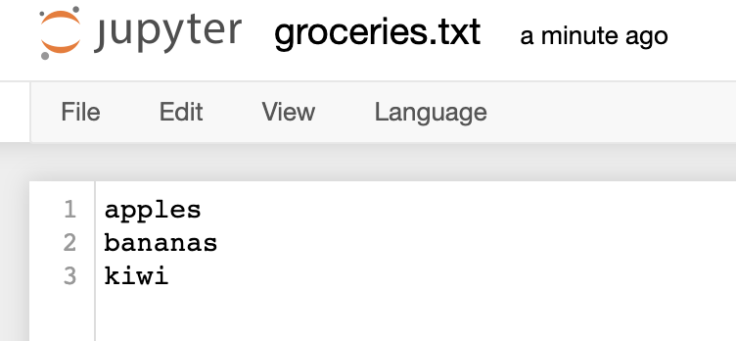
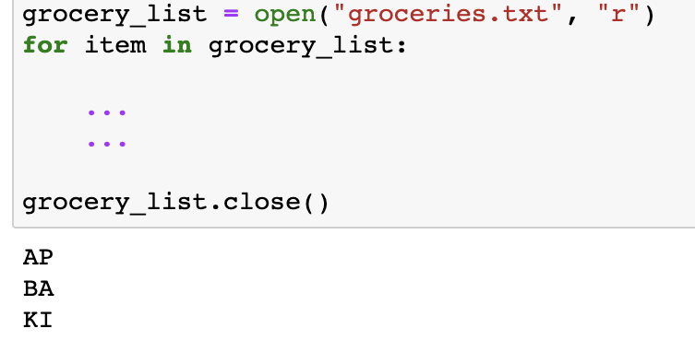
How do you print out the first two characters upper-case per item?
GOODFILE-AS· $1000
Question board

Slide 12
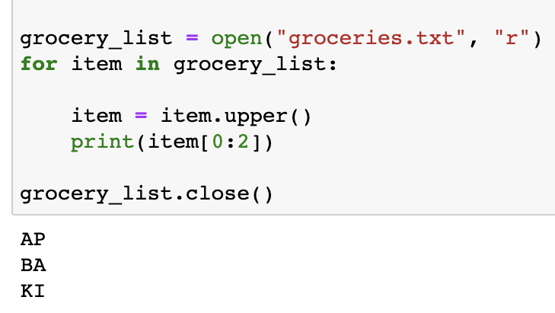
How do you print out the first two characters upper-case per item?
GOODFILE-AS · $1000
Question board

Slide 13
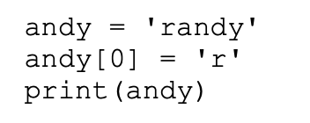
What is the output?
It’s a wonderful aps106· $250
Question board

Slide 14
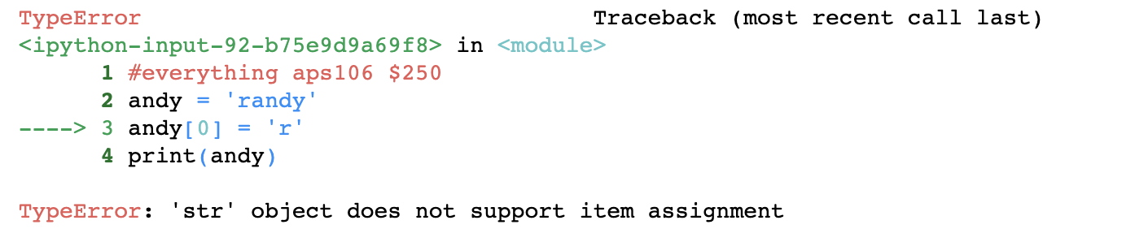
It’s a wonderful aps106· $250
Modified from 2017 final exam
Question board

Slide 15
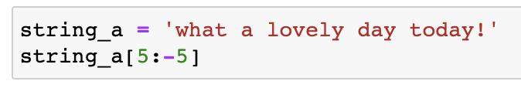
What is the output?
It’s a wonderful aps106· $500
Question board

Slide 16
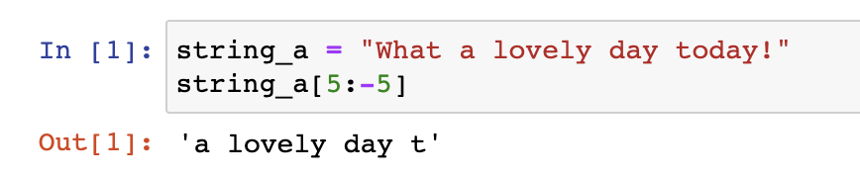
It’s a wonderful aps106· $500
Question board

Slide 17
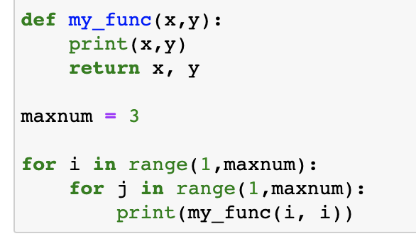
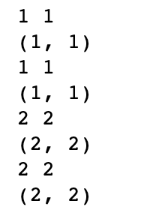
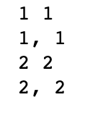
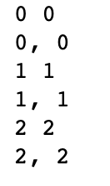
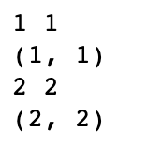
What is the output?
It’s a wonderful aps106· $750
a)
c)
b)
d)
Question board

Slide 18
What is the output?
It’s a wonderful aps106 · $750
a)
c)
b)
d)
Question board

Slide 19
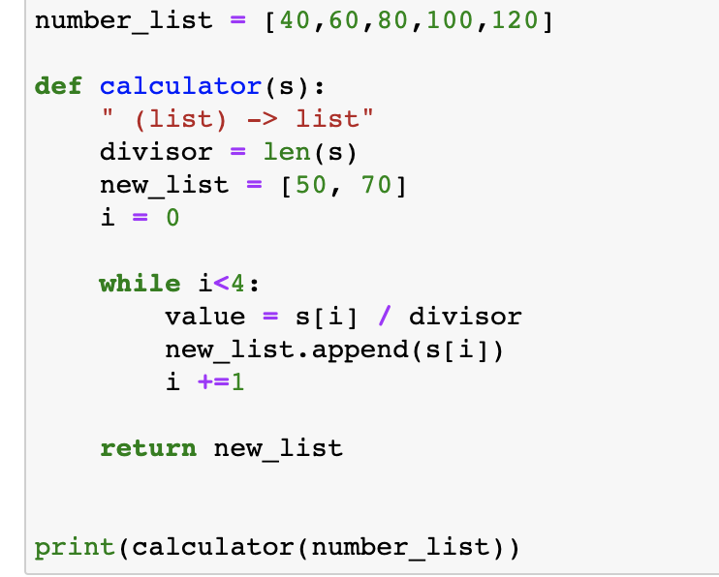
What is the output?
It’s a wonderful aps106 · $1000
Question board

Slide 20
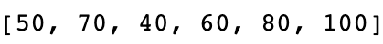
What is the output?
It’s a wonderful aps106 · $1000
Question board

Slide 21
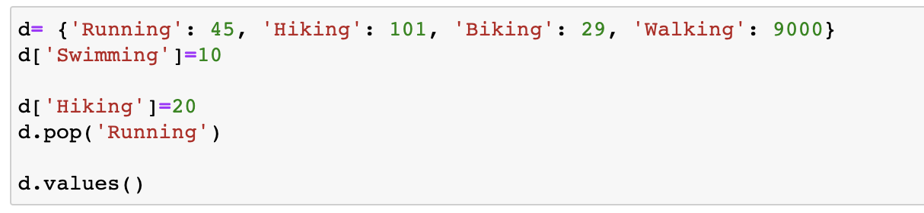
What is the output?
CITIZEN KANE-TAINER· $250
Question board
Notes:
Go to python notebook

Slide 22
What is the output?
CITIZEN KANE-TAINER· $250
Modified from the
2018 final exam
Question board
Notes:
Go to python notebook

Slide 23
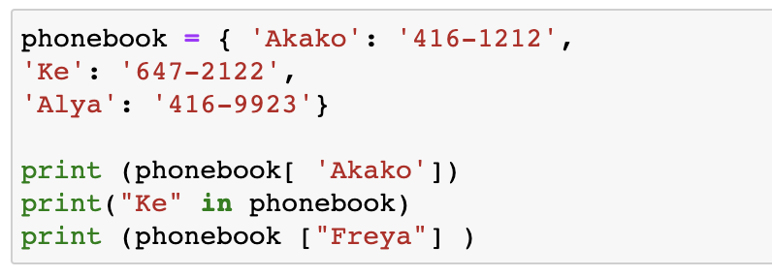
What are the outputs?
CITIZEN KANE-TAINER· $500
Question board

Slide 24
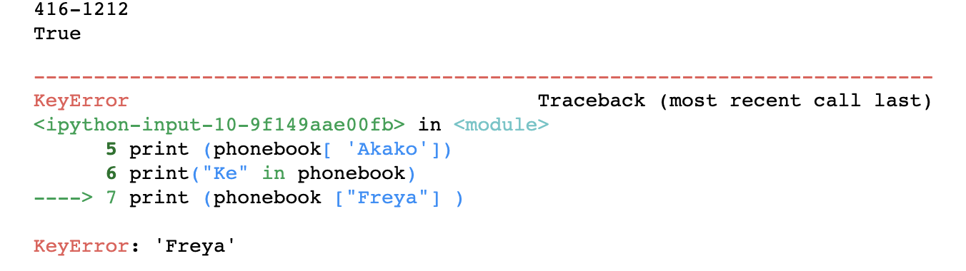
What are the outputs?
CITIZEN KANE-TAINER· $500
Modified from the
2019 final exam
Question board

Slide 25
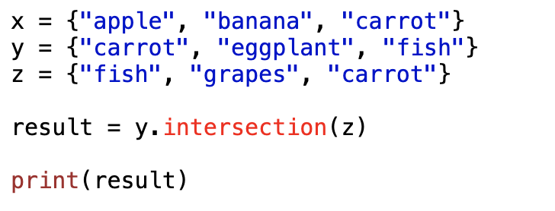
What is the output?
CITIZEN KANE-TAINER· $750
Question board
Notes:
No output

Slide 26

What is the output?
CITIZEN KANE-TAINER· $750
Question board
Notes:
No output

Slide 27
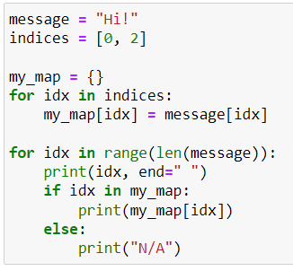
What is the output?
CITIZEN KANE-TAINER· $1000
Question board
Notes:
No output

Slide 28

What is the output?
CITIZEN KANE-TAINER· $1000
Question board
Notes:
No output

Slide 29
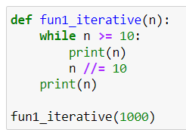
What is the output?
12 ANGRY METHODS · $250
Question board
Notes:
No output

Slide 30

What is the output?
12 ANGRY METHODS · $250
Question board
Notes:
No output

Slide 31
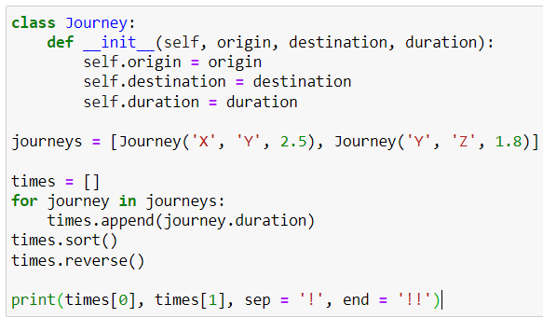
What is the output?
12 ANGRY METHODS · $500
Question board
Notes:
No output

Slide 32
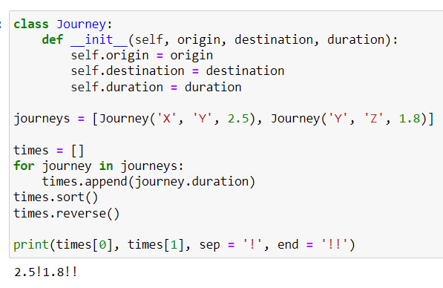
What is the output?
12 ANGRY METHODS · $500
Question board
Notes:
No output

Slide 33
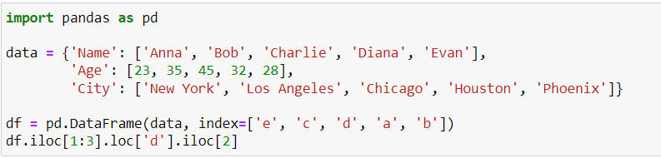
What is the output?
12 ANGRY METHODS · $750
Question board
Notes:
No output

Slide 34
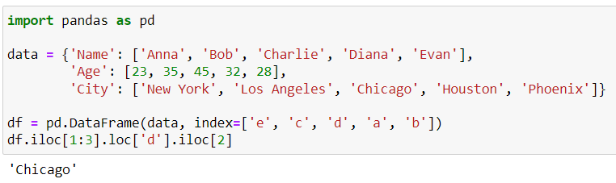
What is the output?
12 ANGRY METHODS · $750
Question board
Notes:
No output

Slide 35
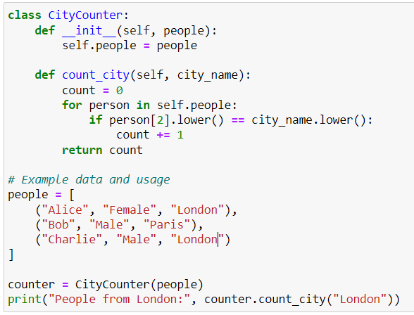
What is the output?
12 ANGRY METHODS · $1000
Question board
Notes:
No output

Slide 36
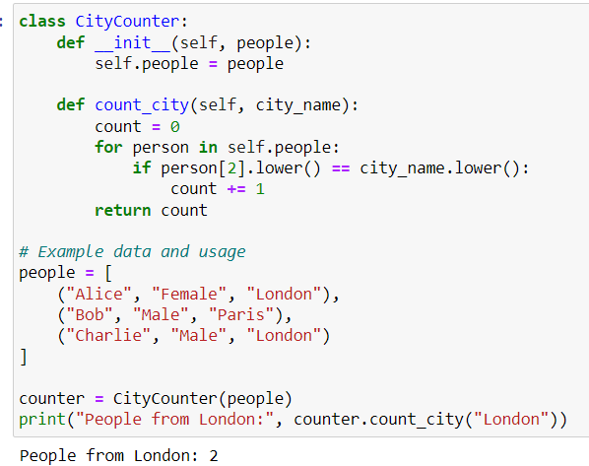
What is the output?
12 ANGRY METHODS · $1000
Question board
Notes:
No output

Slide 37
Final Jeopardy

Slide 38
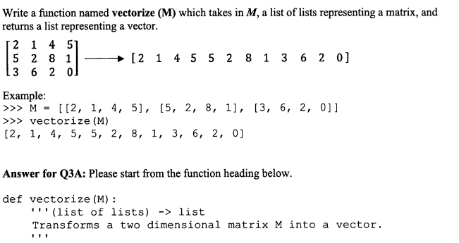
Question 1 · FINAL JEOPARDY

Slide 39
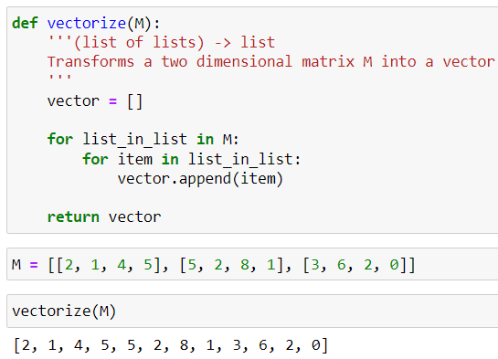
Our solution:
Question 1 · FINAL JEOPARDY

Slide 40
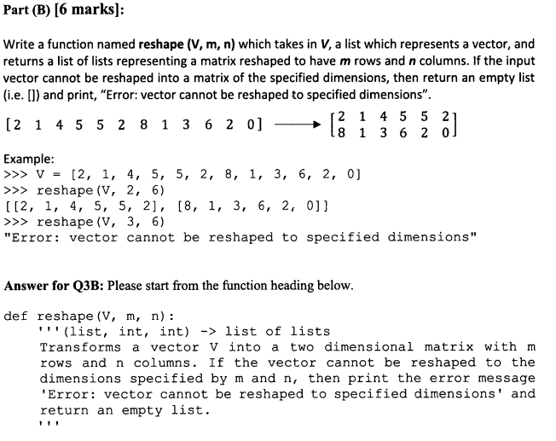
Question 1 · FINAL JEOPARDY

Slide 41
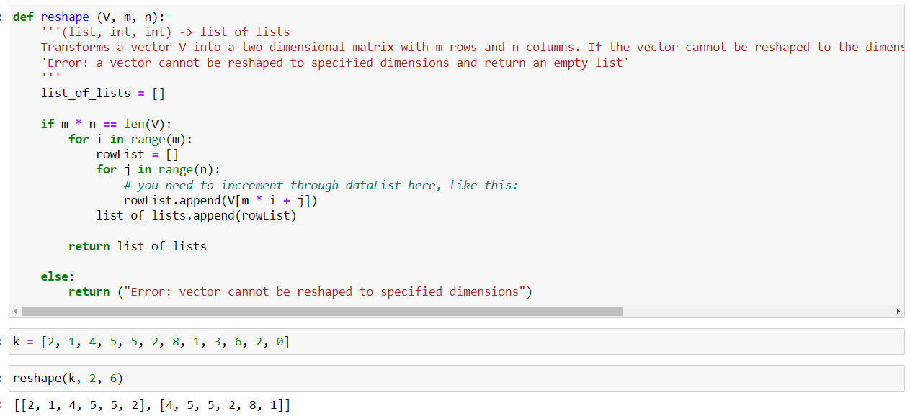
Our solution:
Question 1 · FINAL JEOPARDY

Slide 42
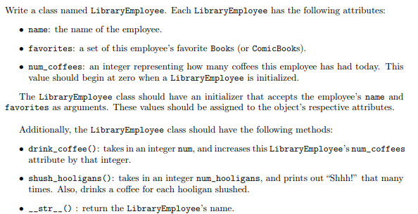
EXTRA Question · FINAL JEOPARDY
Copyright: Stanford

